Slide 1
Development Environment Setup
Module - 2

Slide 2
Contents
Installing the SAP Hybris Commerce Suite
Build Framework
Basic Configuration
hybris server
hac
Initialization and Update
Extension Concept
Eclipse Integration

Slide 3
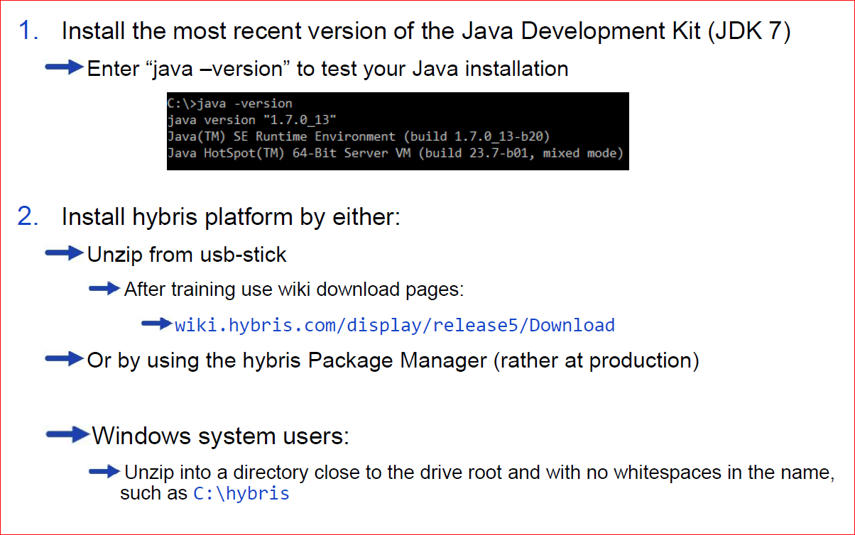
Quick Installation Guide

Slide 4
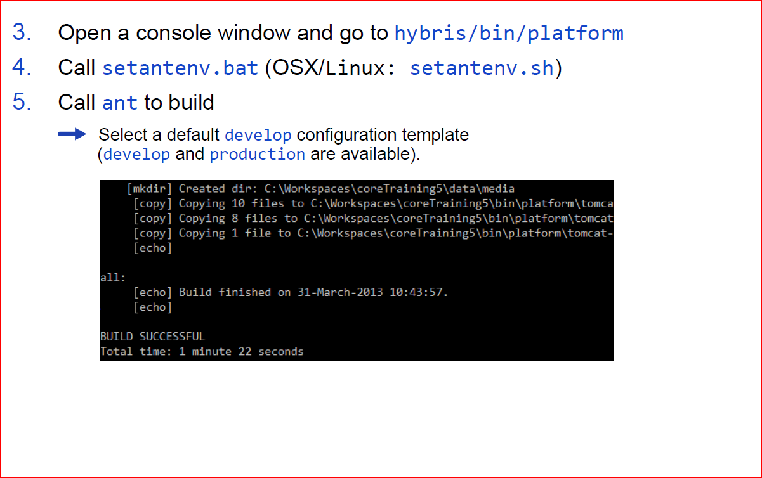
Quick Installation Guide

Slide 5
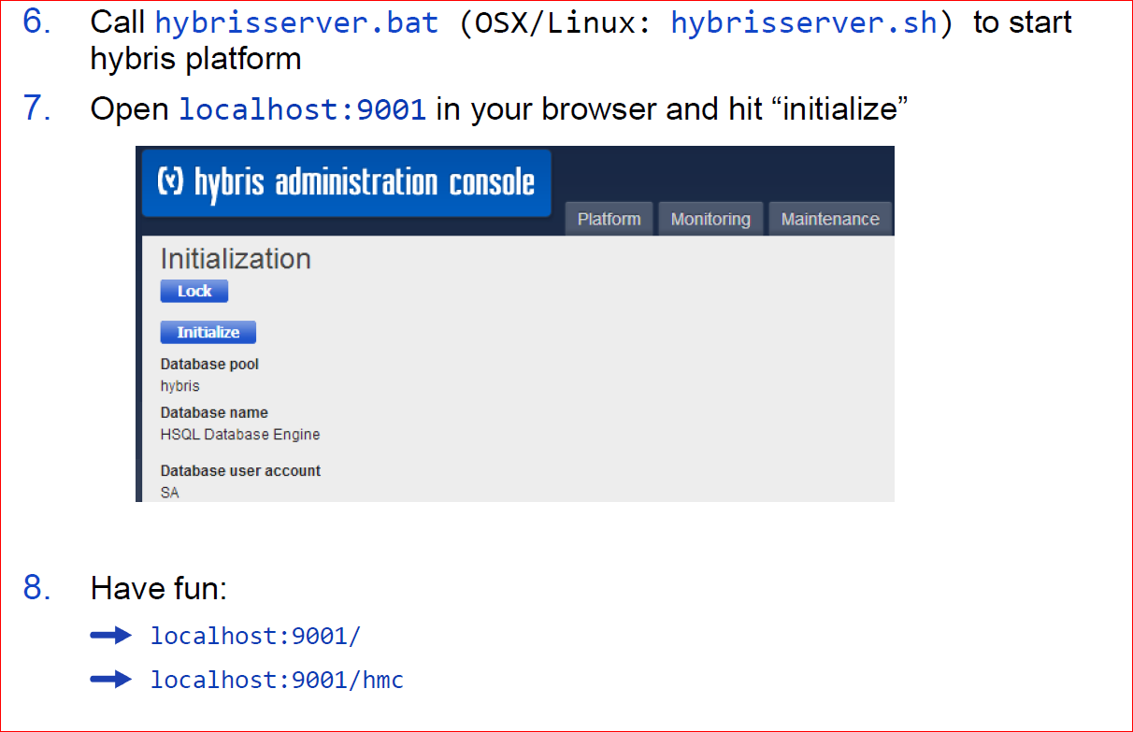
Quick Installation Guide

Slide 6
Contents
Installing the hybris Commerce Suite
Build Framework
Basic Configuration
hybris server
hac
Initialization and Update
Extension Concept
Eclipse Integration

Slide 7
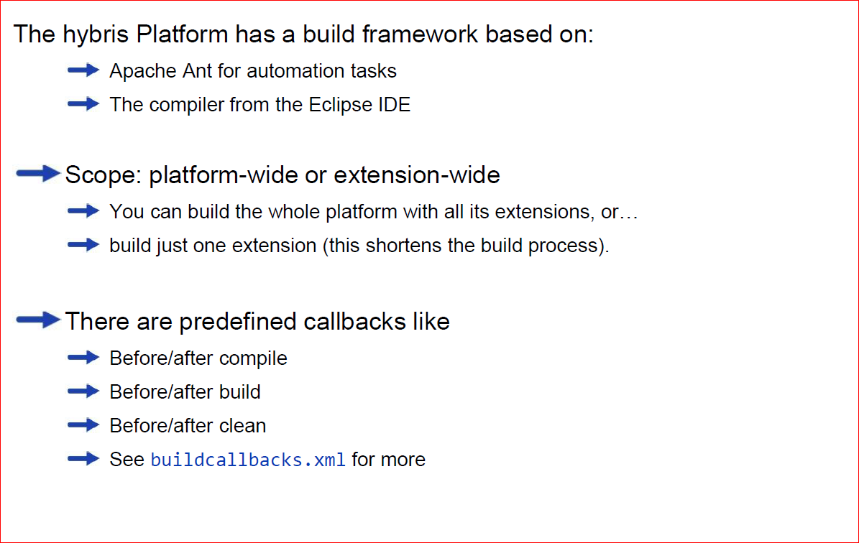
Build Framework

Slide 8
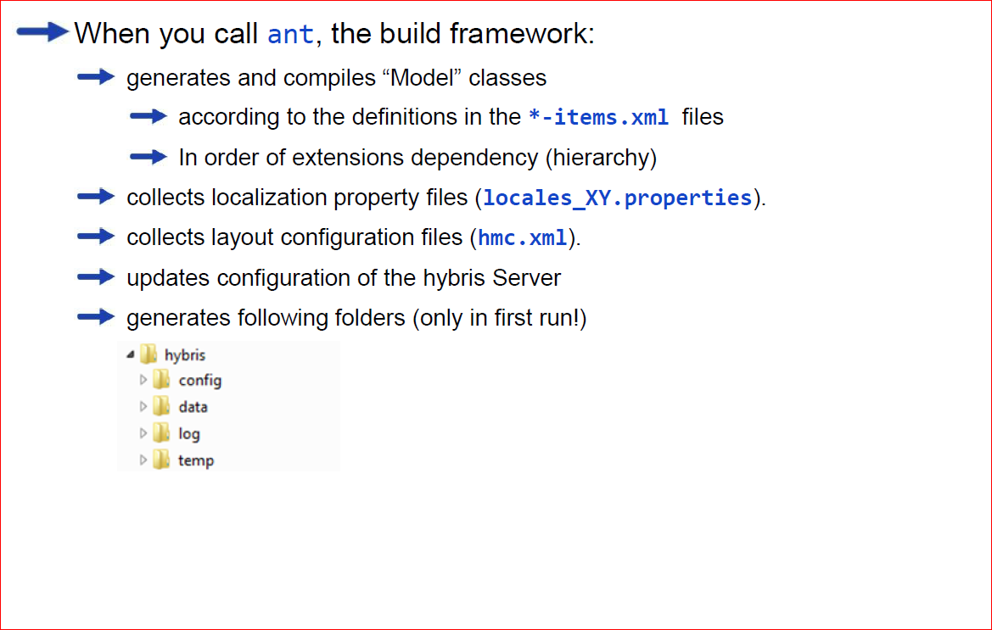
Building with ant

Slide 9
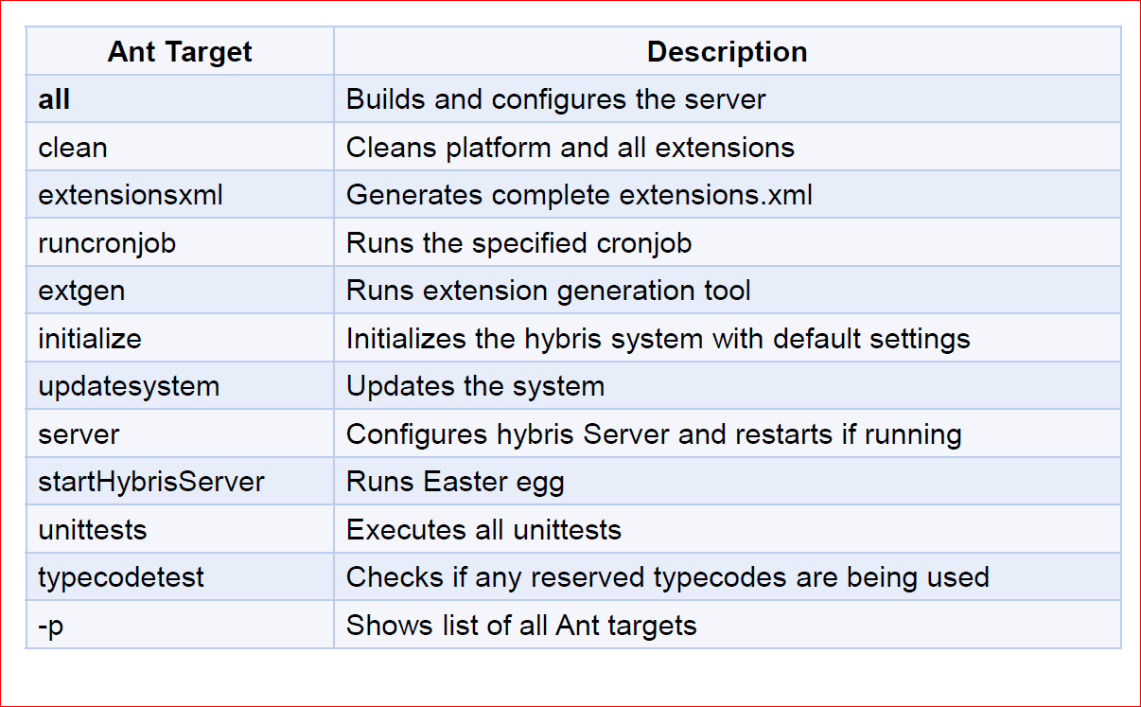
Build Targets

Slide 10
Contents
Installing the hybris Commerce Suite
Build Framework
Basic Configuration
hybris server
hac
Initialization and Update
Extension Concept
Eclipse Integration

Slide 11
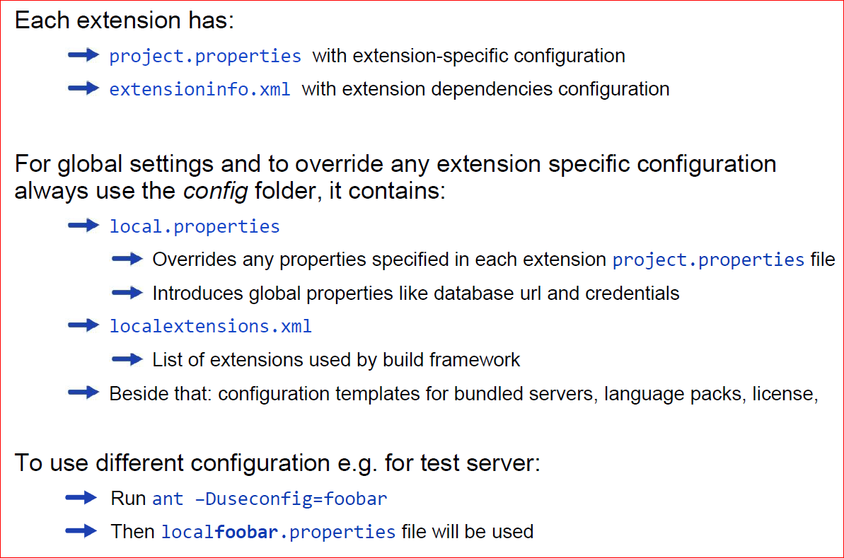
Configuration Files

Slide 12
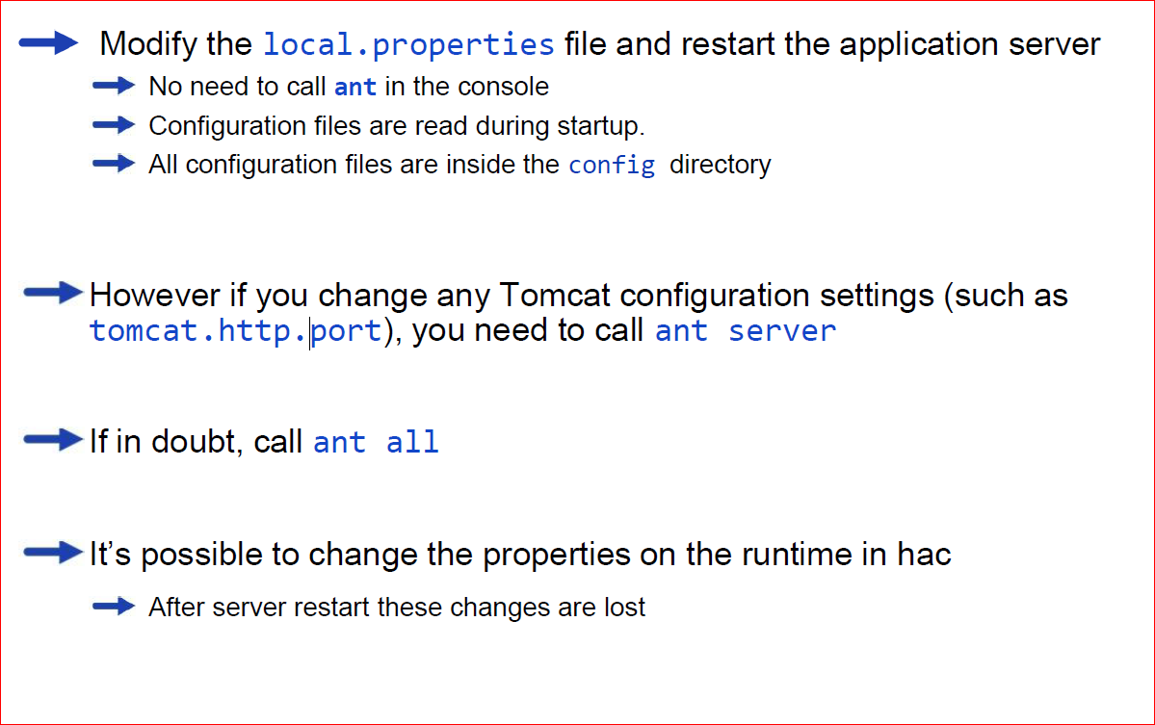
Configuration changes

Slide 13
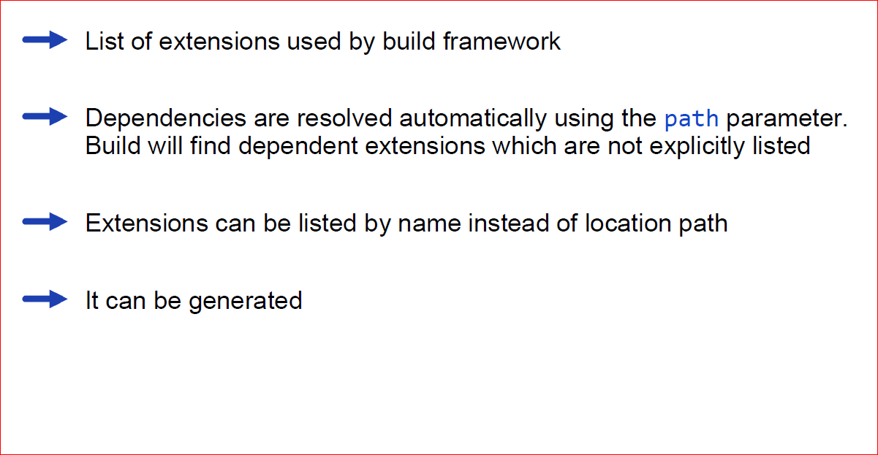
localextensions.xml

Slide 14
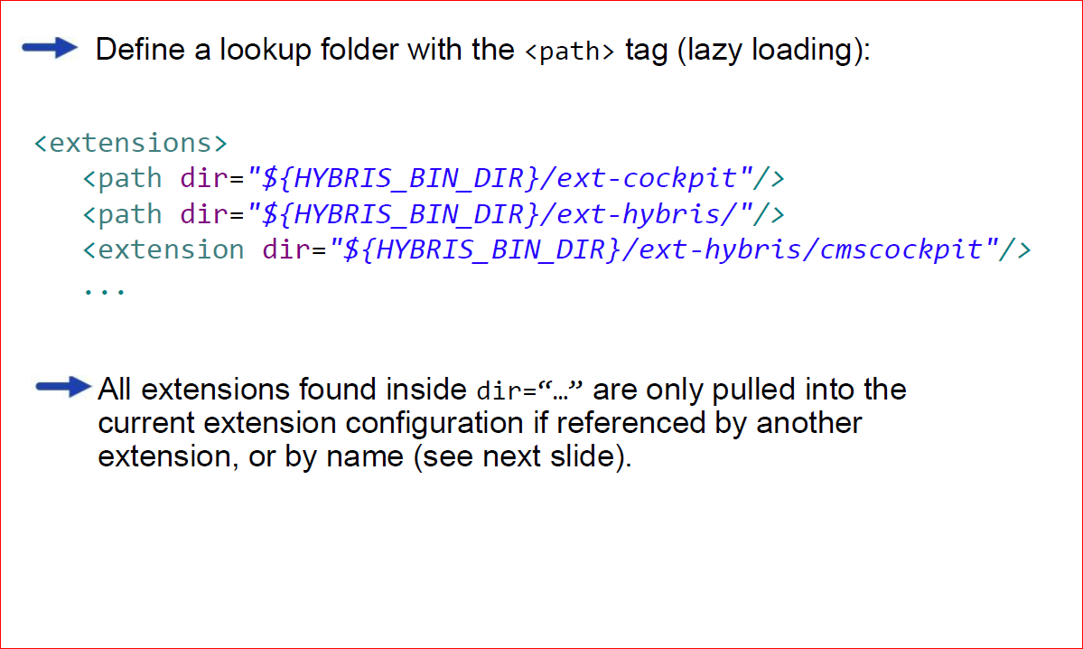
Load Required Extensions

Slide 15
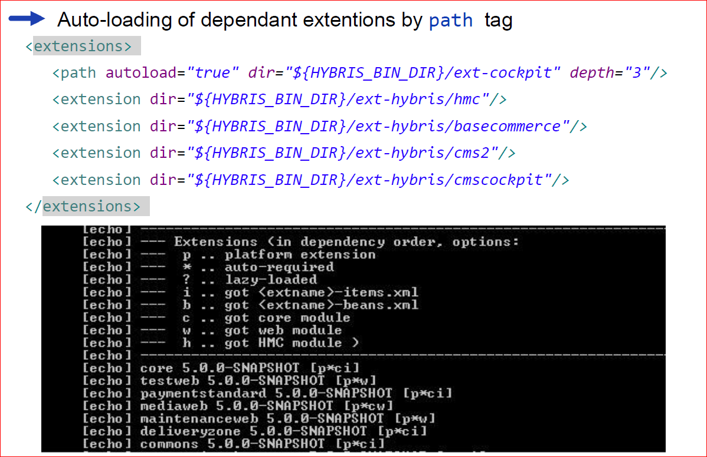
Loading All Extensions in a Folder

Slide 16
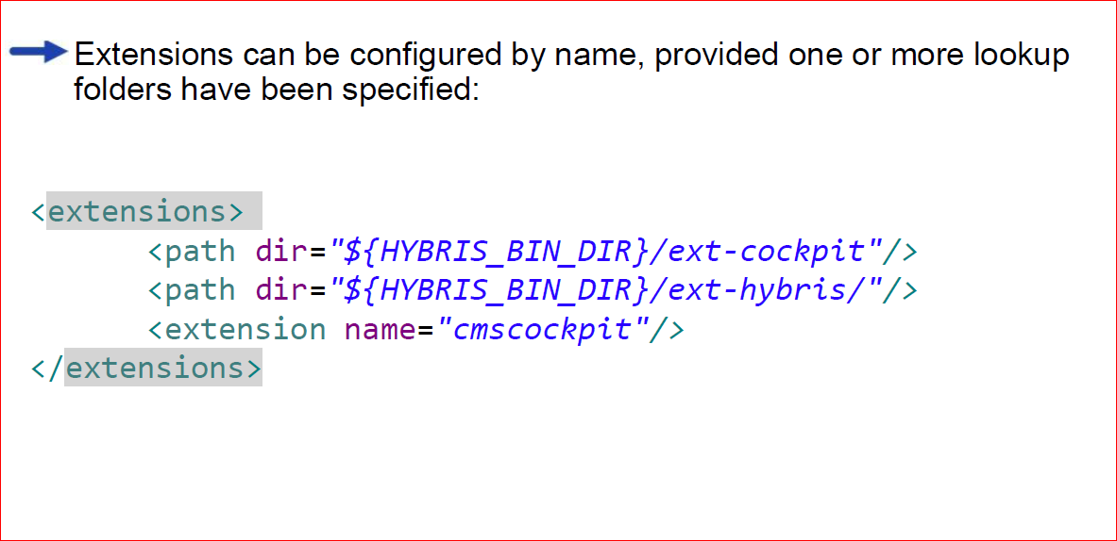
Load Extension by Name

Slide 17
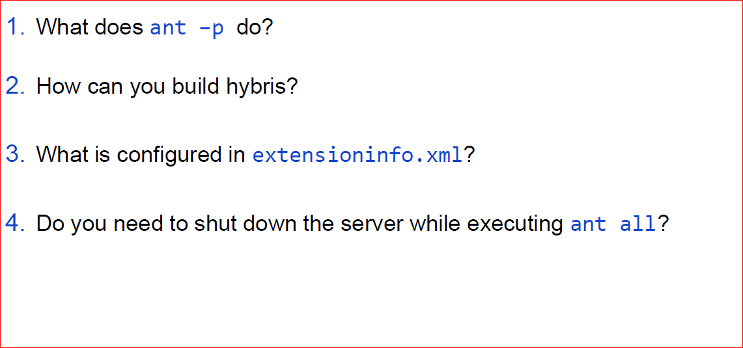
Quizzies

Slide 18
Contents
Installing the hybris Commerce Suite
Build Framework
Basic Configuration
hybris server
hac
Initialization and Update
Extension Concept
Eclipse Integration

Slide 19
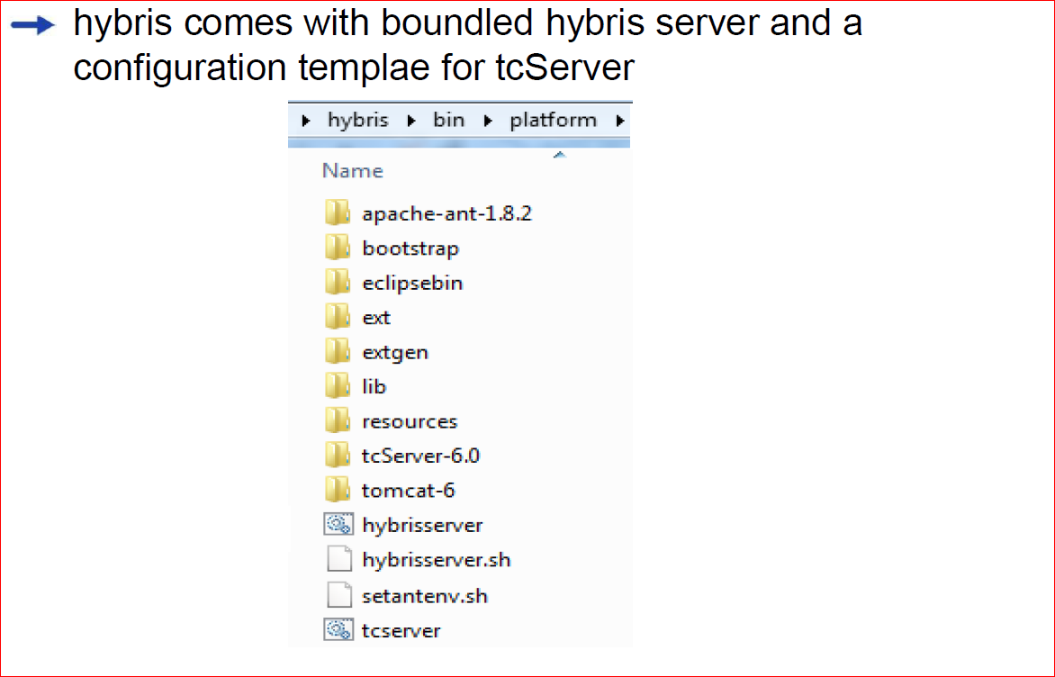
Bundled With hybris

Slide 20
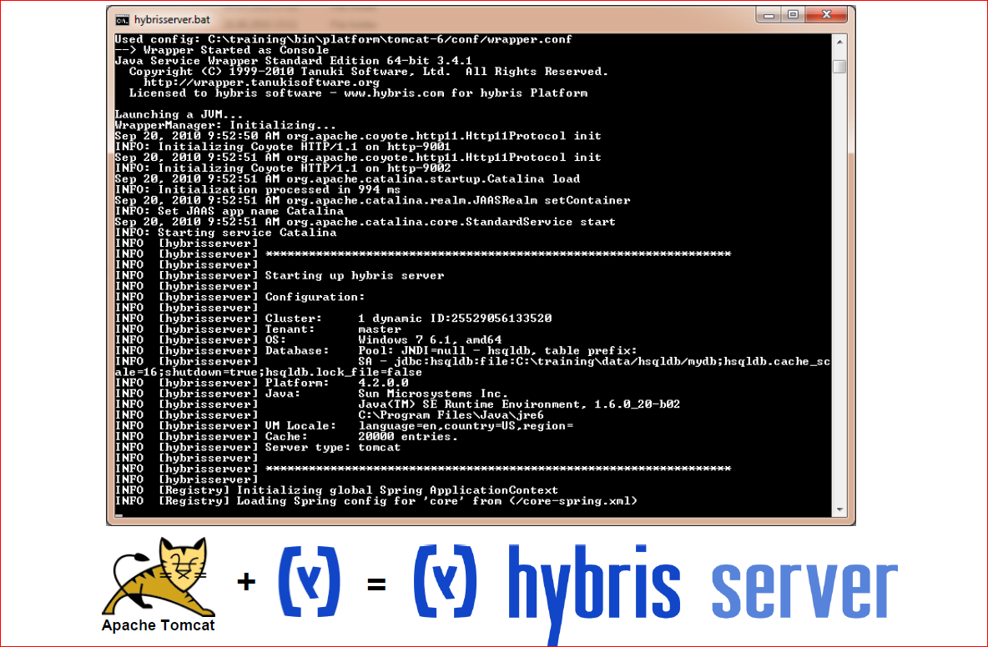
hybris Server

Slide 21
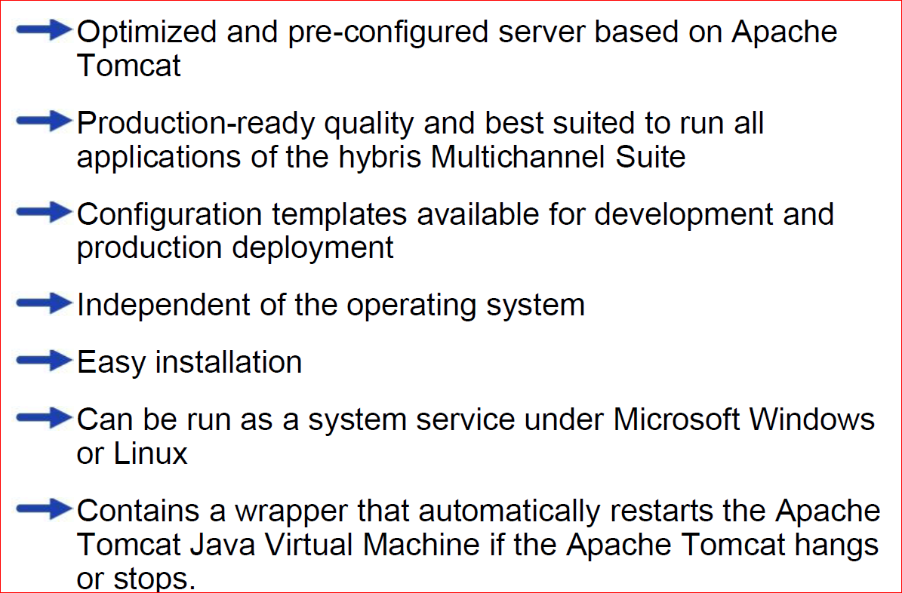
What is the hybris Server?

Slide 22
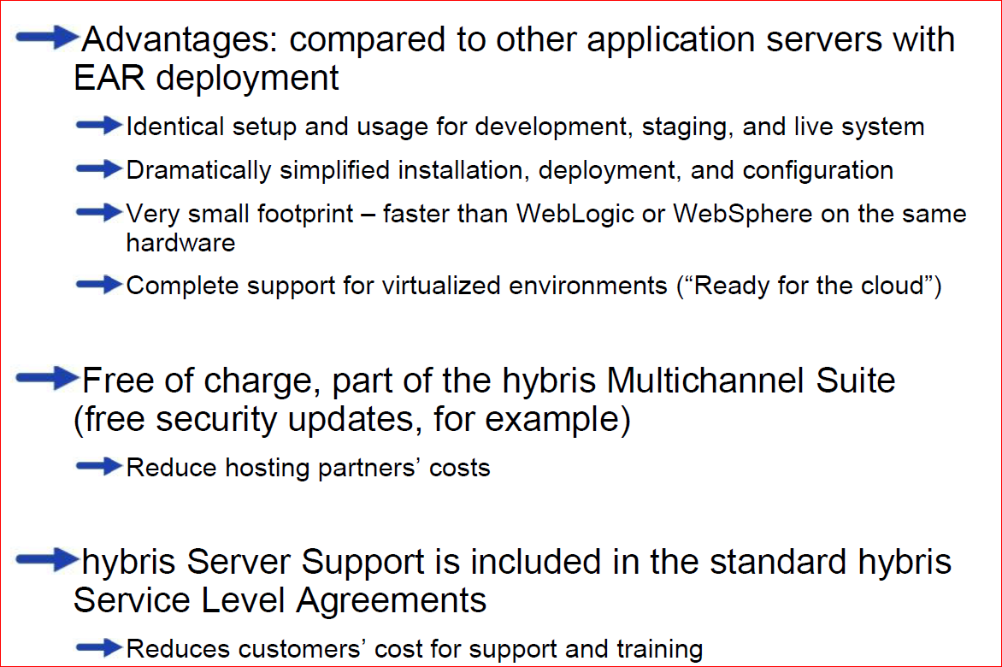
Advantages of the hybris Server

Slide 23
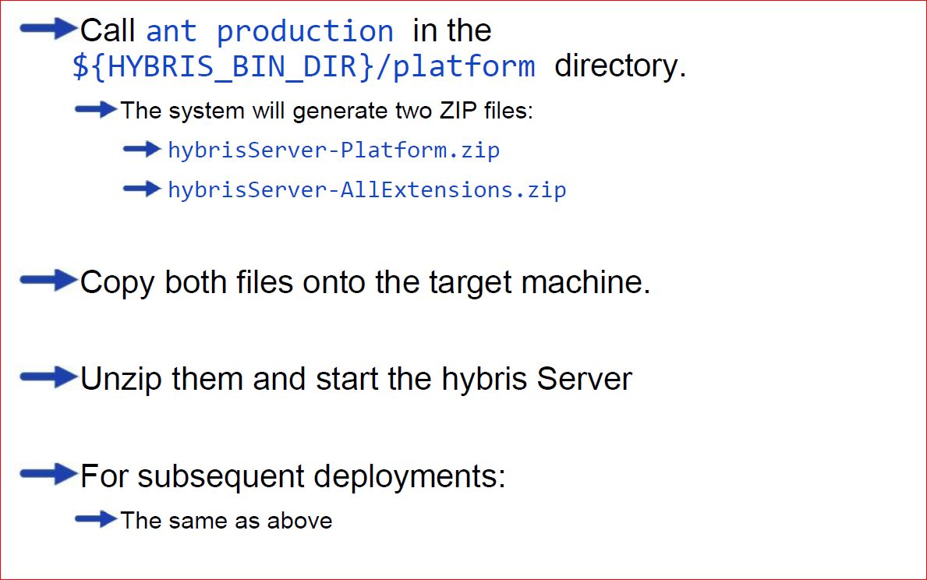
Deploying with the hybris Server

Slide 24
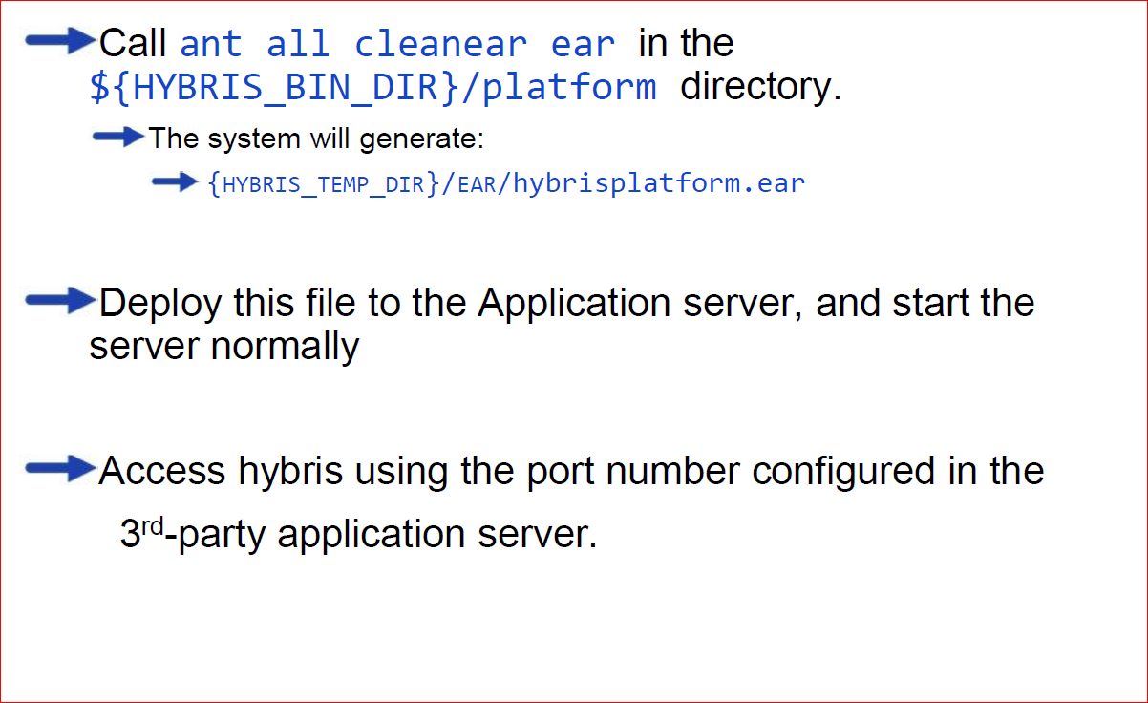
Deploying Onto a non-Tomcat Server (WebLogic or WebSphere)

Slide 25
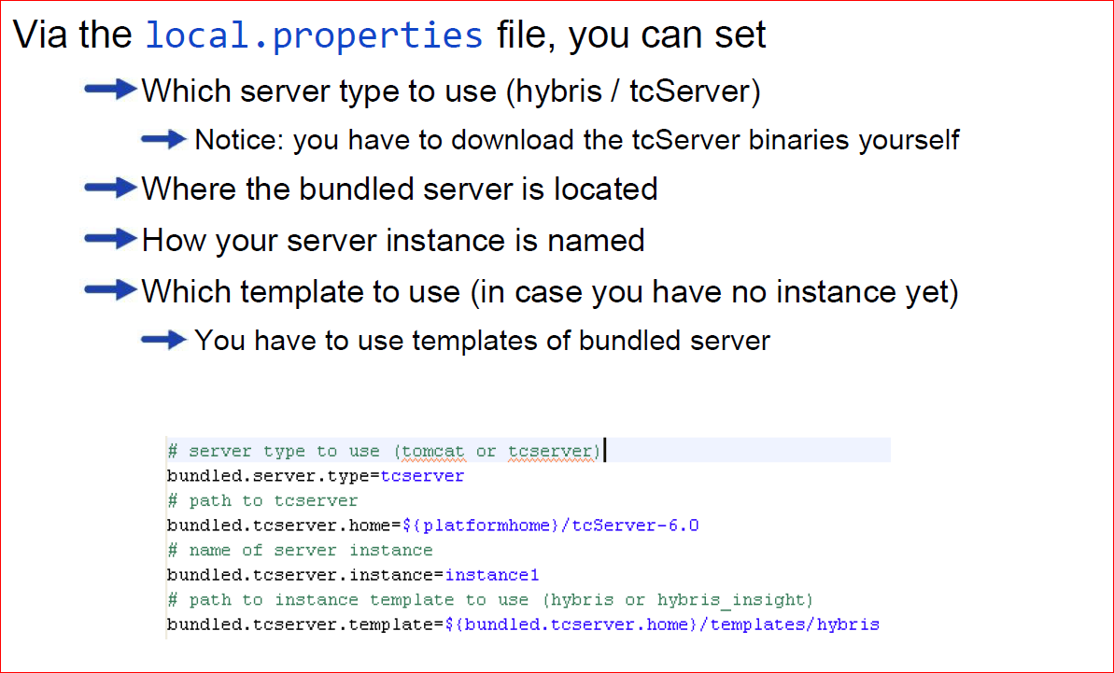
Switching to tcServer

Slide 26
Contents
Installing the hybris Commerce Suite
Build Framework
Basic Configuration
hybris server
hac
Initialization and Update
Extension Concept
Eclipse Integration

Slide 27
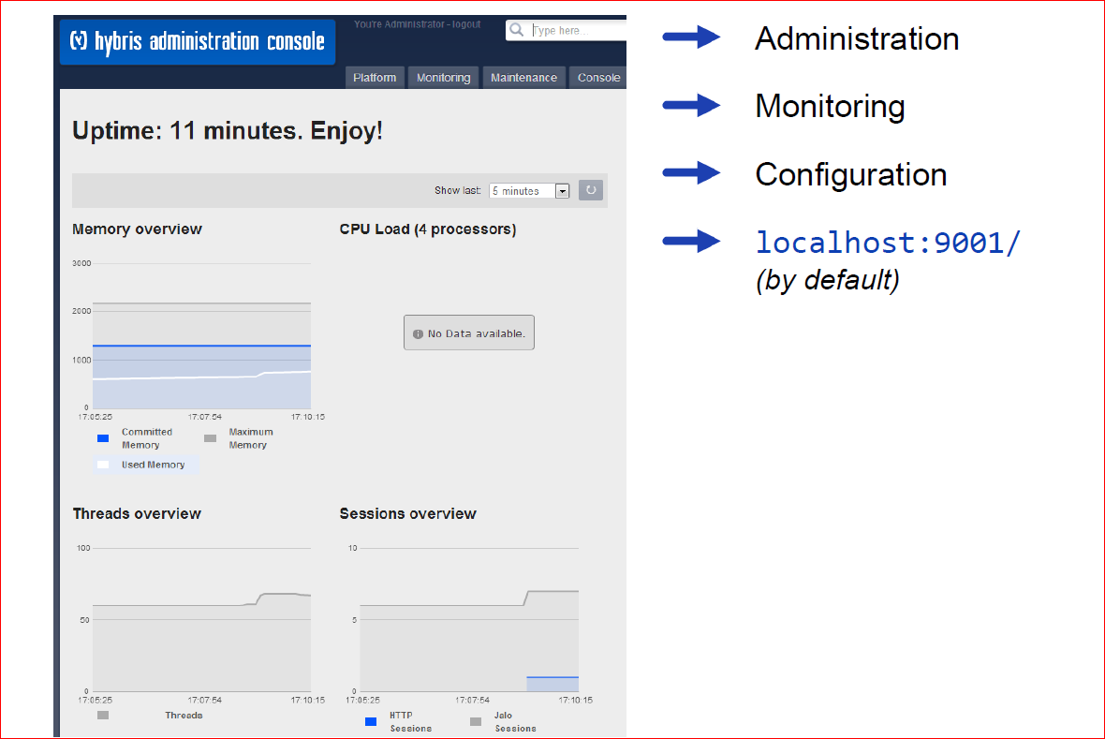
hac - hybris Administration Console

Slide 28
Contents
Installing the hybris Commerce Suite
Build Framework
Basic Configuration
hybris server
hac
Initialization and Update
Extension Concept
Eclipse Integration

Slide 29
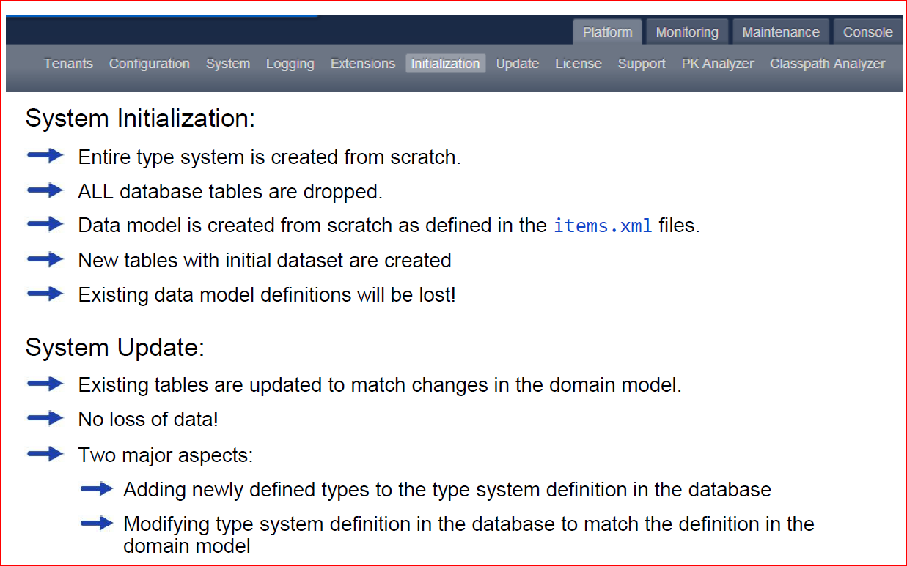
Initialize or Update the System

Slide 30
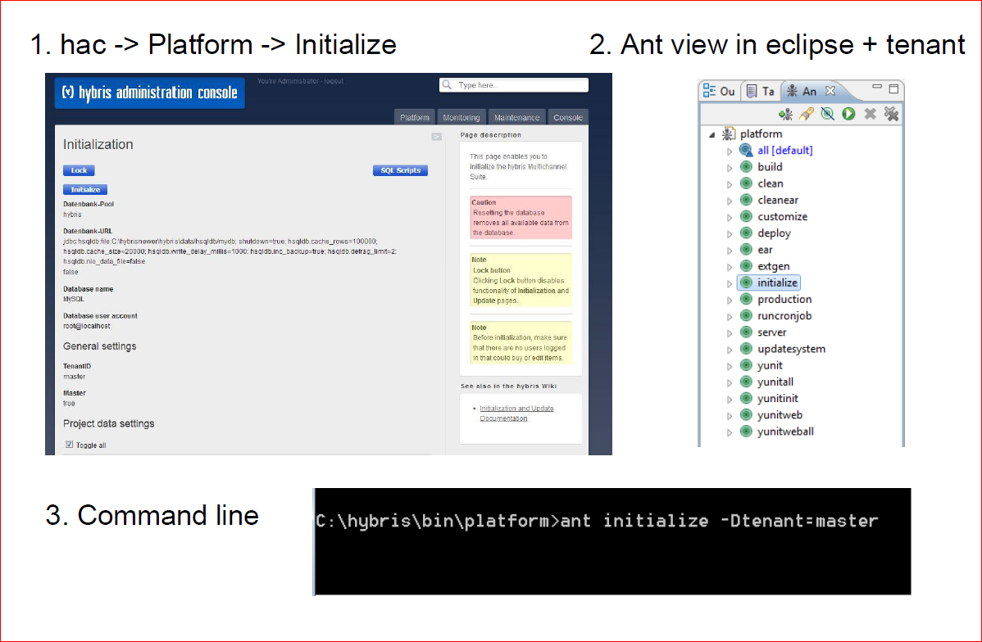
Initialization

Slide 31
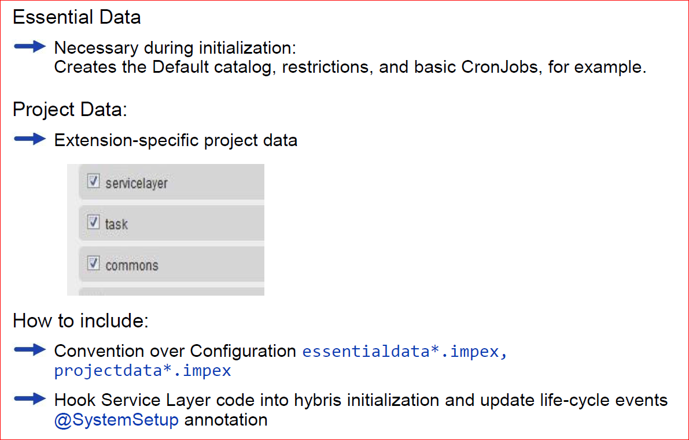
Essential Data vs. Project Data

Slide 32
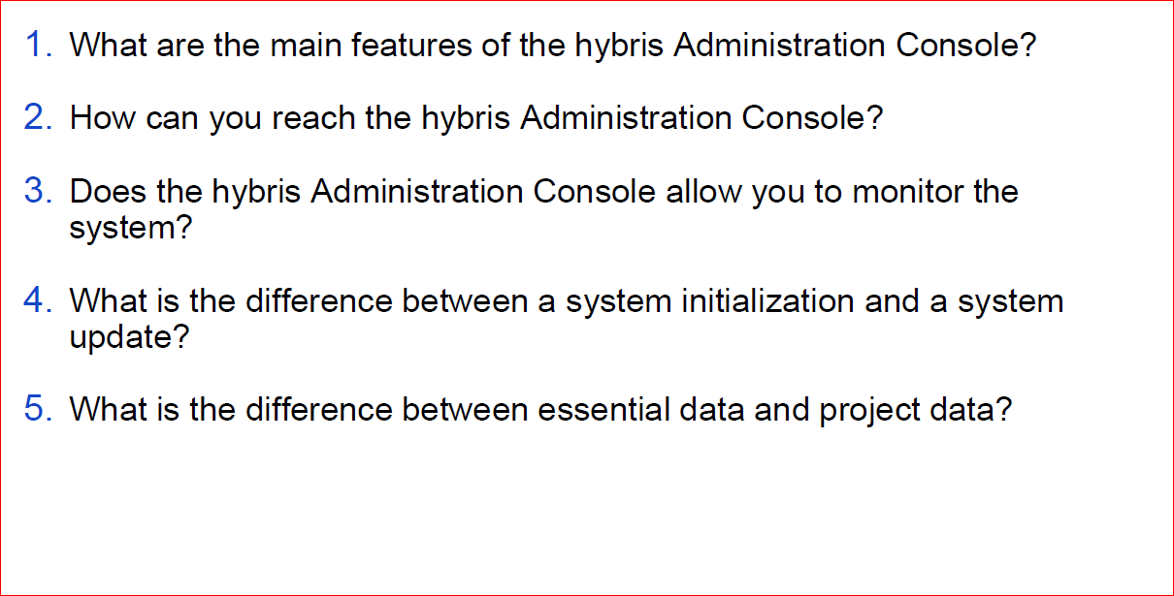
Quizzies

Slide 33
Contents
Installing the hybris Commerce Suite
Build Framework
Basic Configuration
hybris server
hac
Initialization and Update
Extension Concept
Eclipse Integration

Slide 34
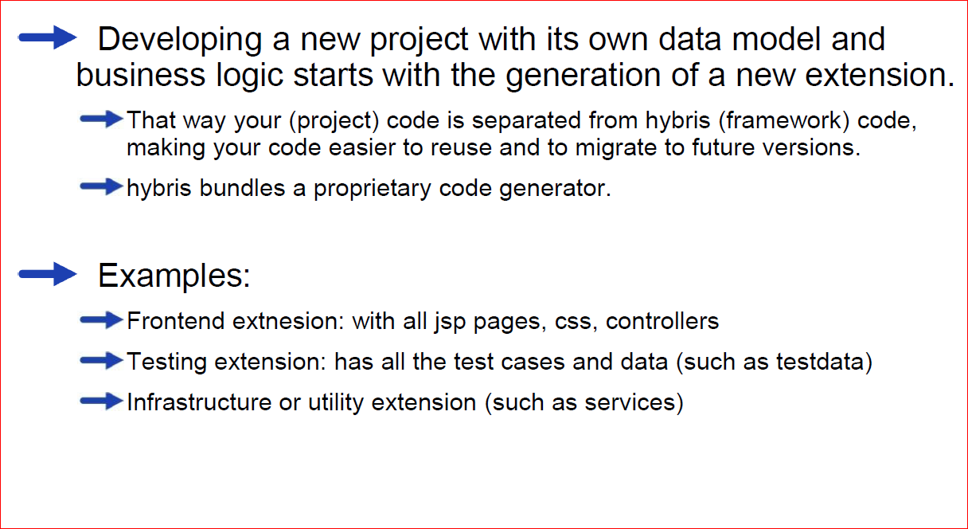
Where to Begin

Slide 35
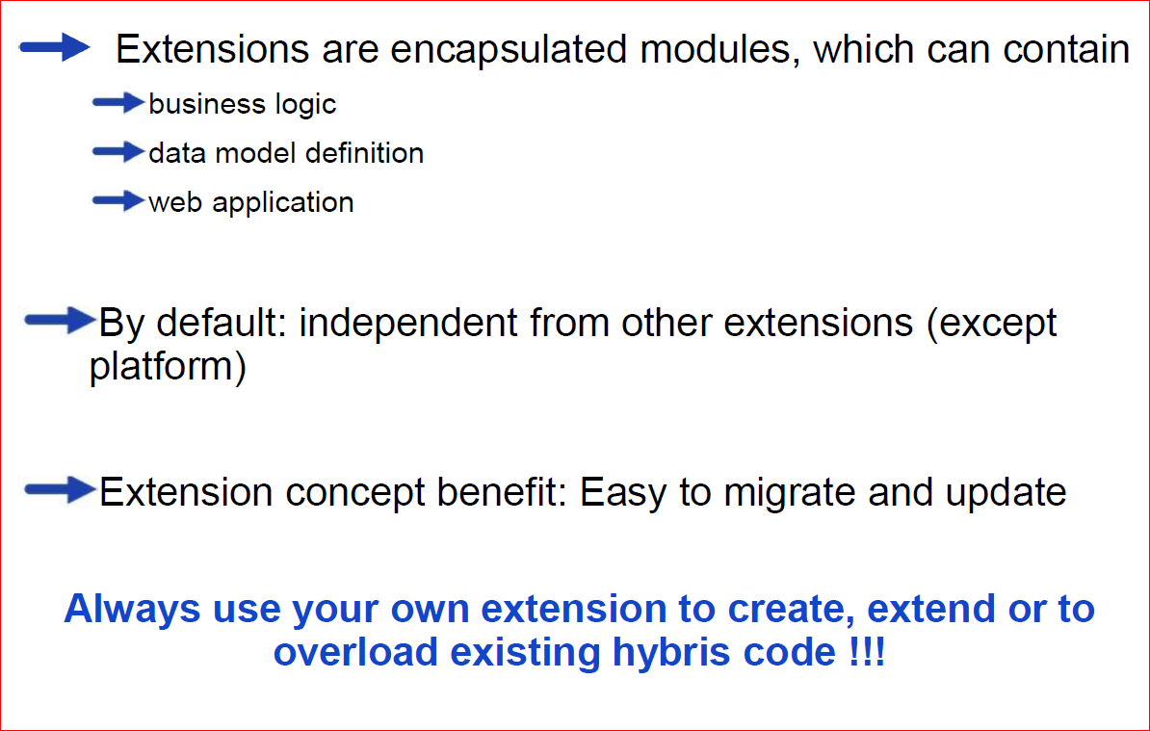
Extension Basics

Slide 36
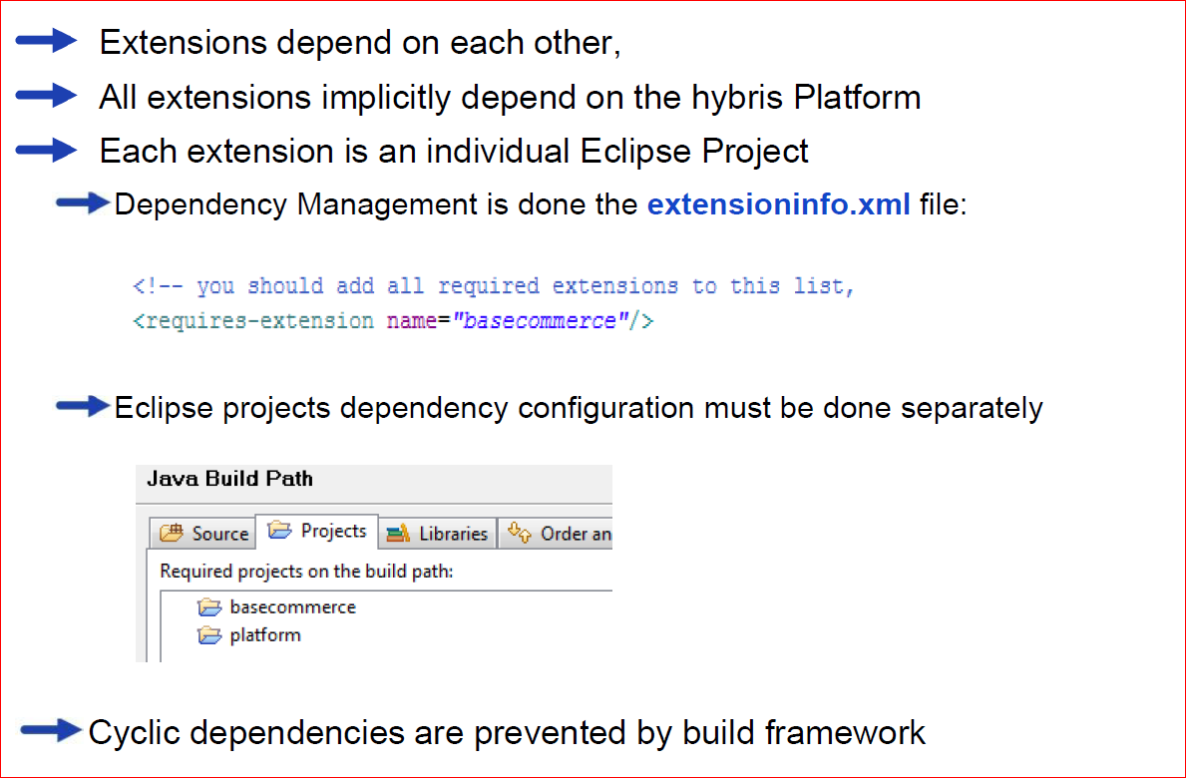
Extension Dependency Management

Slide 37
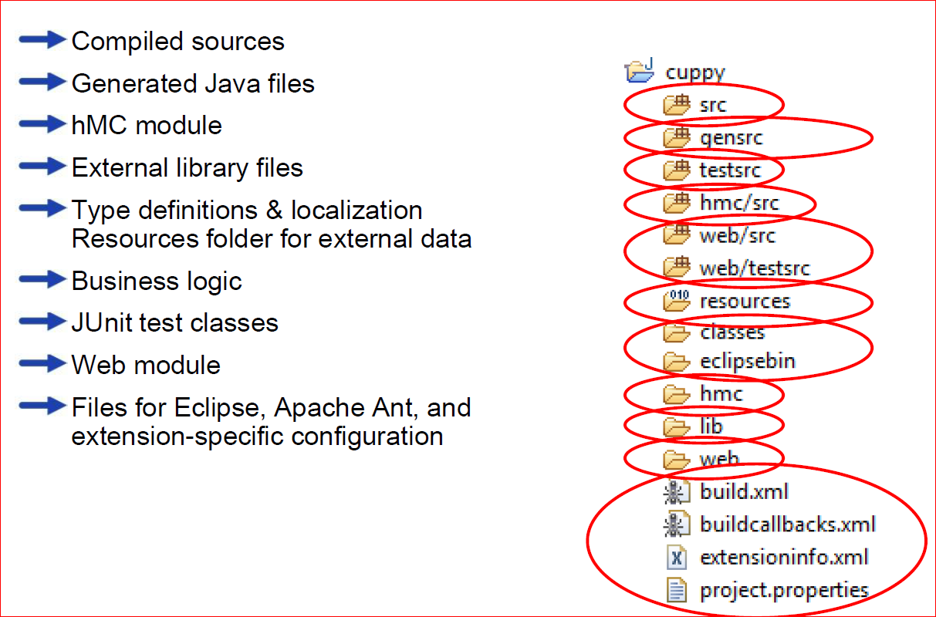
Structure of an Extension

Slide 38
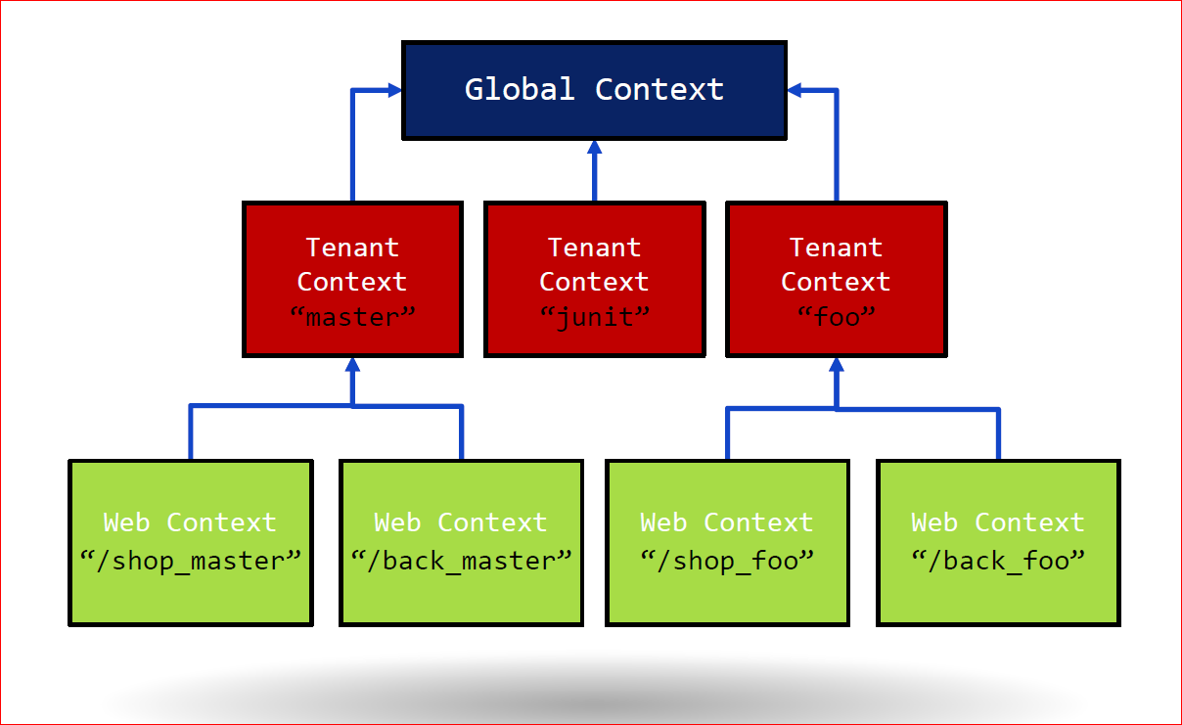
Spring contexts

Slide 39
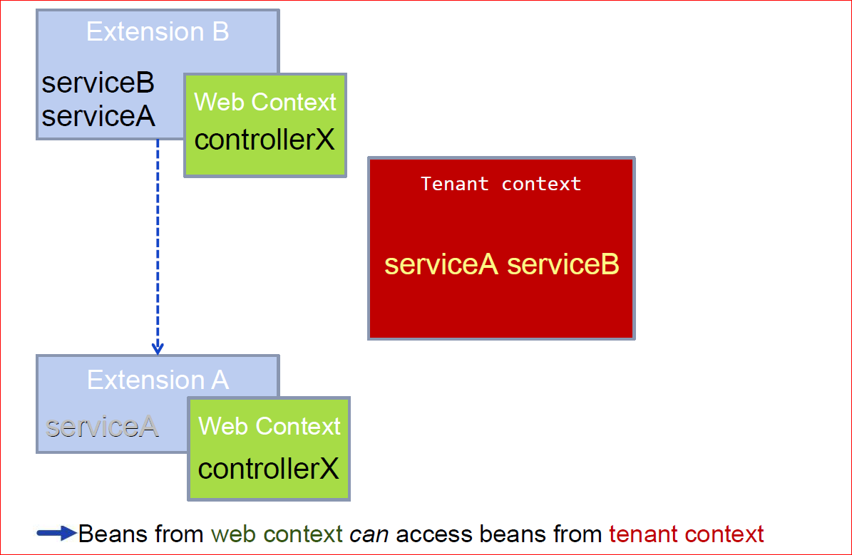
Spring configuration of extensions

Slide 40
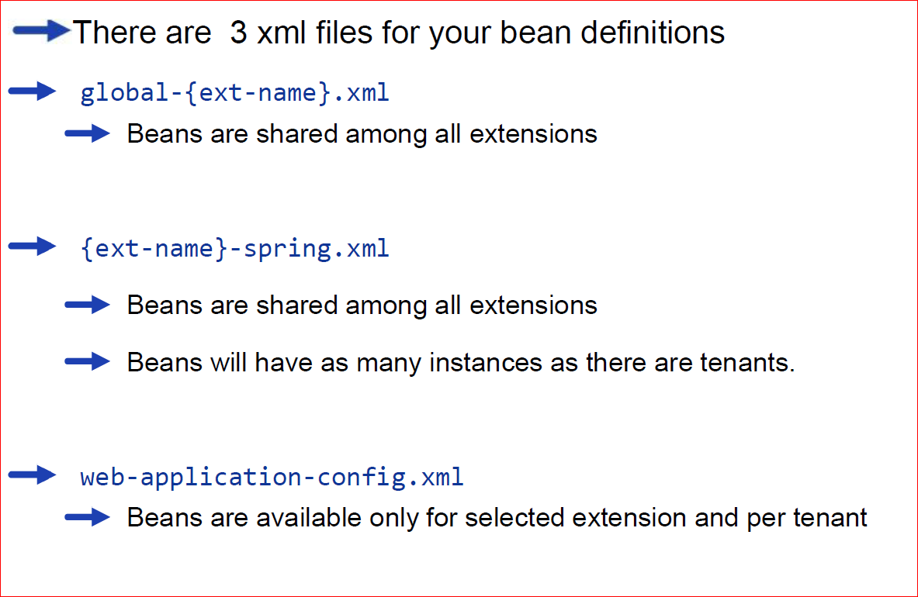
Spring configuration of extension

Slide 41
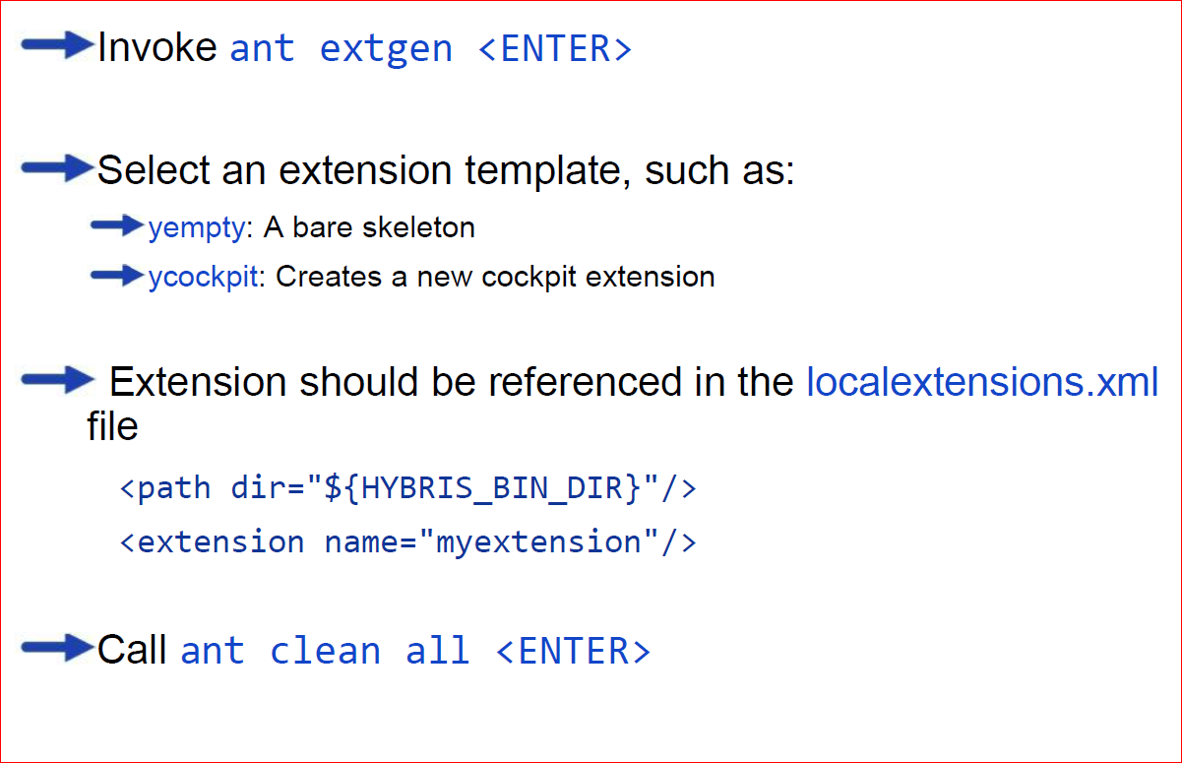
How to Create a New Extension

Slide 42
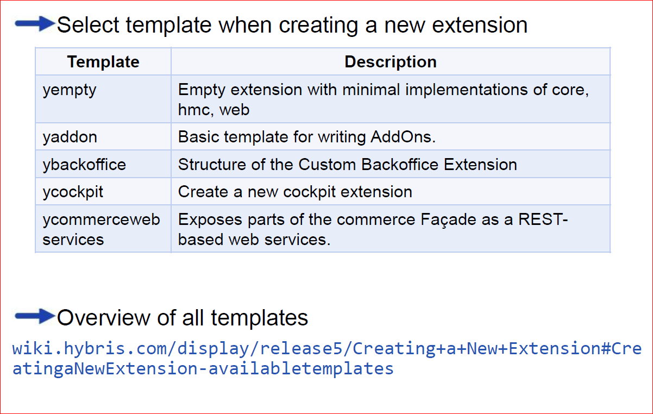
Platform and Technology Templates

Slide 43
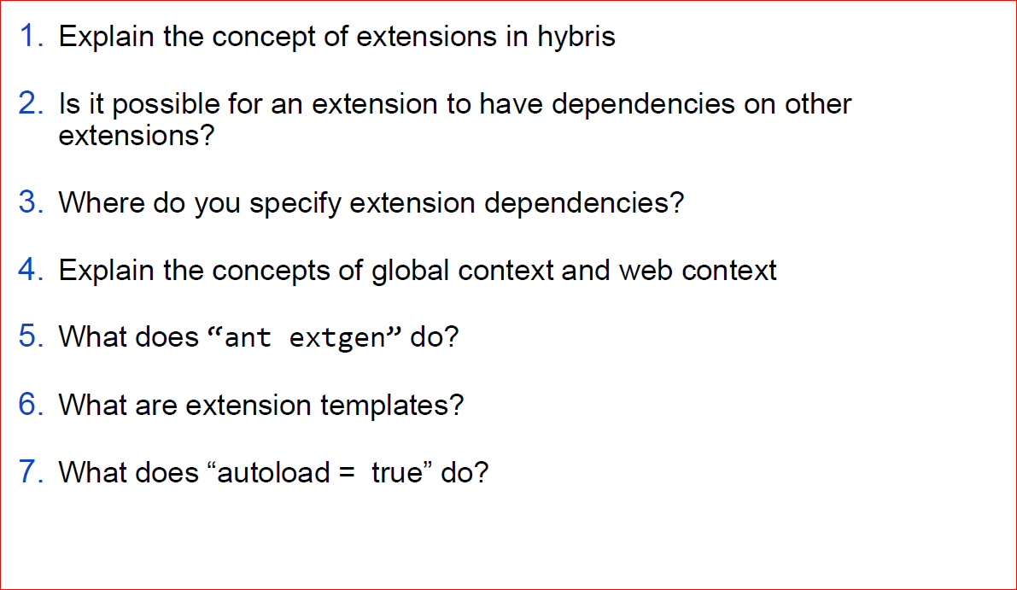
Quizzies

Slide 44
Contents
Installing the hybris Commerce Suite
Build Framework
Basic Configuration
hybris server
hac
Initialization and Update
Extension Concept
Eclipse Integration

Slide 45
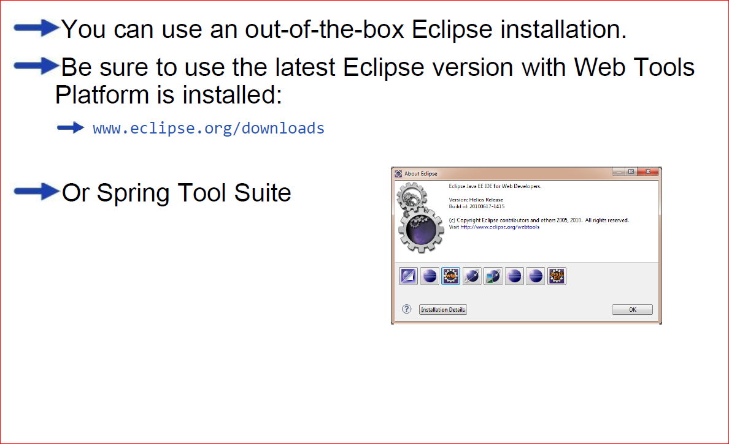
Your Eclipse Installation

Slide 46
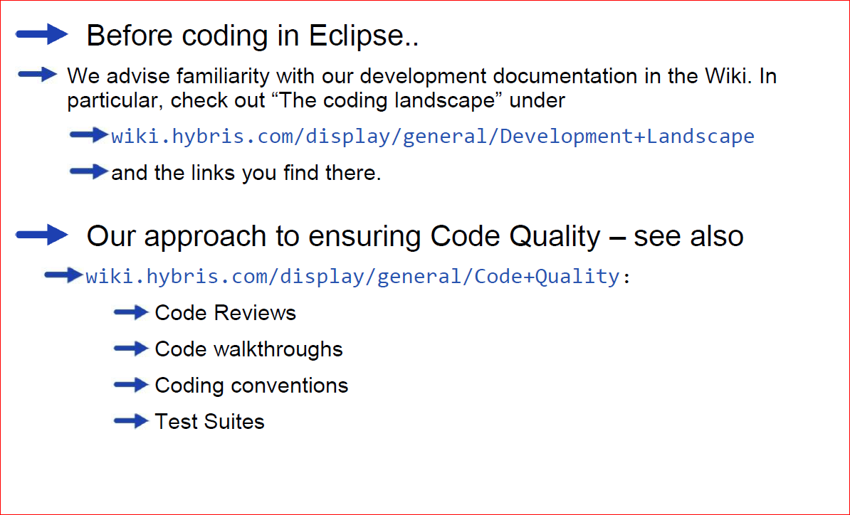
Your Eclipse Installation

Slide 47
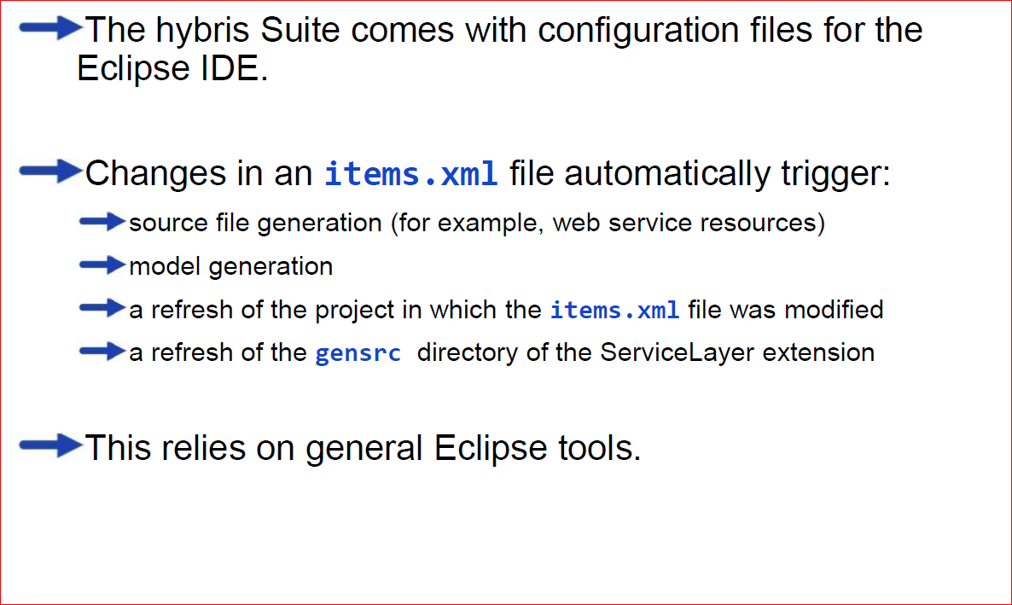
Eclipse Enhancements for Faster Development

Slide 48
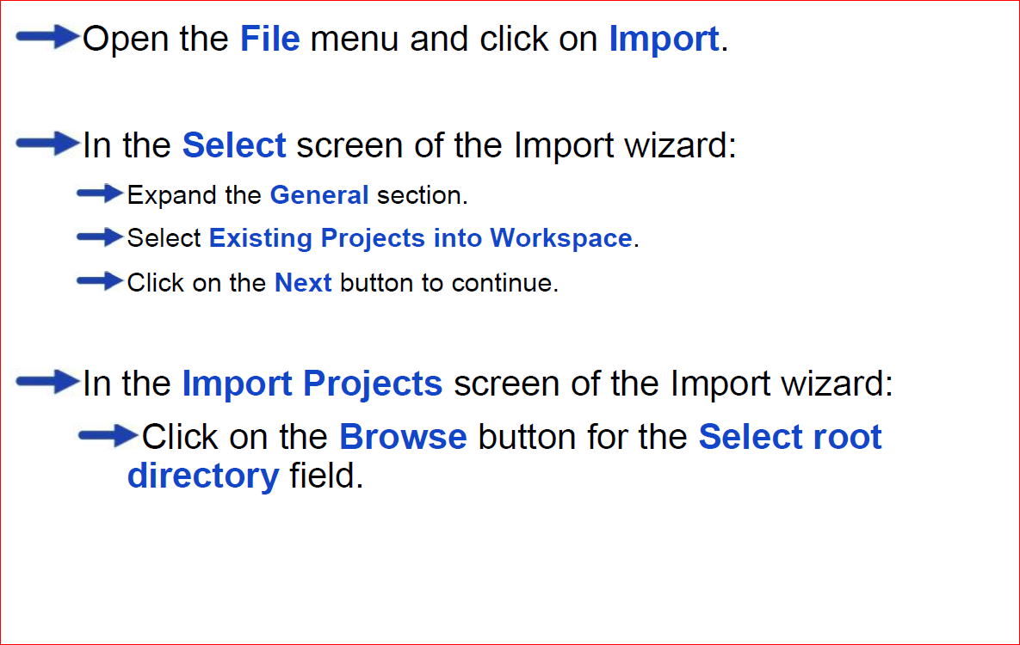
Importing the hybris Suite as an Eclipse Project

Slide 49
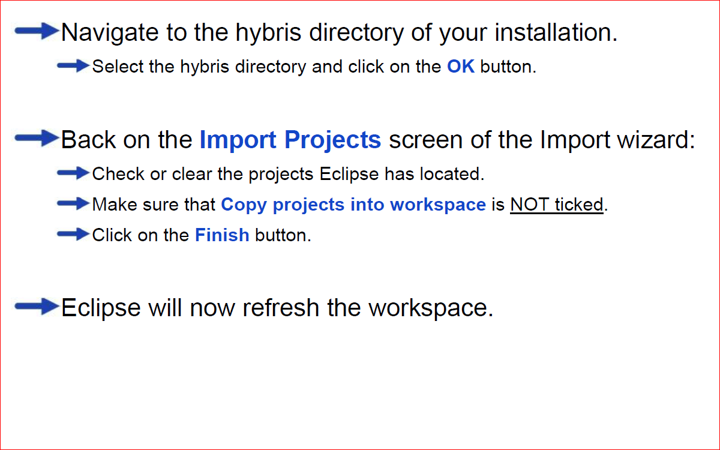
Importing the hybris Suite as an Eclipse Project

Slide 50
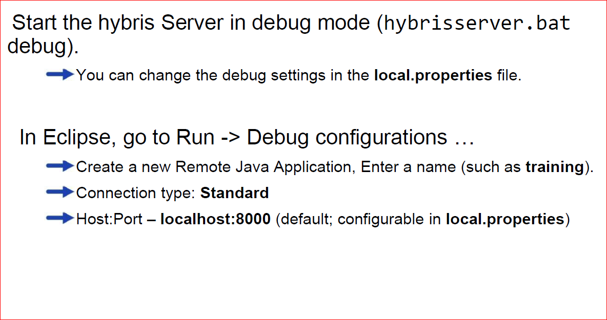
Debugging with Eclipse IDE

Slide 51
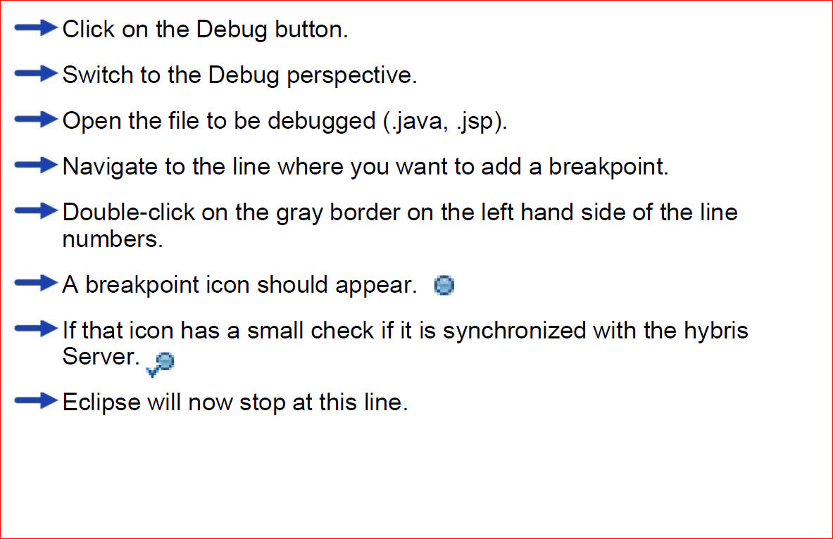
Debugging with Eclipse IDE

Slide 52
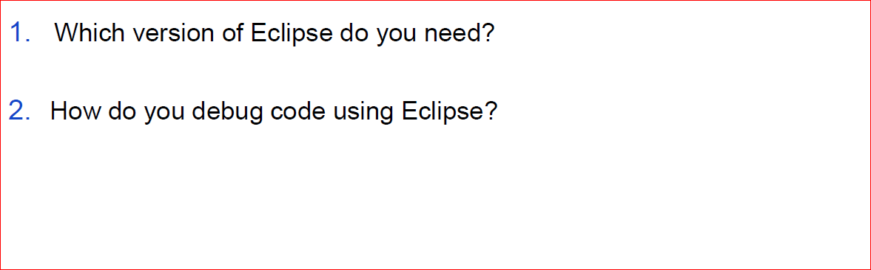
Quizzies

